Slide 1
Learning Big Data Introduction
Aditya Konda
Big Data Engineer

Slide 2



Introduction:

Slide 3


NoSQL Databases

Slide 4








Hadoop Components

Slide 5



Hadoop Distributions

Slide 6
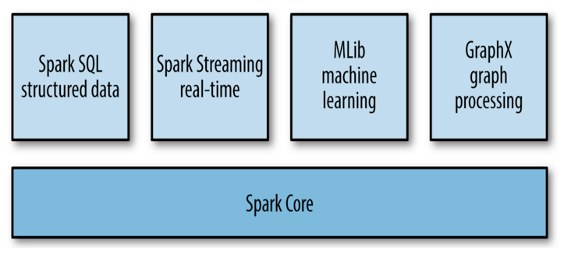
Apache Spark

Slide 7



Cloud Technologies

Slide 8



Things to do

Slide 9


